Slide 1

Chapter 26
Remote Logging,
Electronic Mail,
and File Transfer
26.<number>
Copyright © The McGraw-Hill Companies, Inc. Permission required for reproduction or display.

Slide 2
26-2 ELECTRONIC MAIL
One of the most popular Internet services is electronic mail (e-mail). The designers of the Internet probably never imagined the popularity of this application program. Its architecture consists of several components that we discuss in this chapter.
Topics discussed in this section:
Architecture
User Agent
Message Transfer Agent: SMTP
Message Access Agent: POP and IMAP
Web-Based Mail
26.<number>

Slide 3

Figure 26.6 First scenario in electronic mail
26.<number>

Slide 4

Note
When the sender and the receiver of an e-mail are on the same system,
we need only two user agents.
26.<number>

Slide 5

Figure 26.7 Second scenario in electronic mail
26.<number>

Slide 6
Note
When the sender and the receiver of an e-mail are on different systems, we
need two UAs and a pair of
MTAs (client and server).
26.<number>

Slide 7

Figure 26.8 Third scenario in electronic mail
26.<number>

Slide 8
Note
When the sender is connected to the mail server via a LAN or a WAN,
we need two UAs and two pairs
of MTAs (client and server).
26.<number>

Slide 9

Figure 26.9 Fourth scenario in electronic mail
26.<number>

Slide 10

Figure 26.10 Push versus pull in electronic email
26.<number>

Slide 11
Note
When both sender and receiver are connected to the mail server via
a LAN or a WAN, we need two
UAs, two pairs of MTAs
and a pair of MAAs.
This is the most common situation today.
26.<number>

Slide 12

Figure 26.11 Services of user agent
26.<number>

Slide 13
Note
Some examples of command-driven user agents are mail, pine,
and elm.
26.<number>

Slide 14
Note
Some examples of GUI-based user agents are Eudora, Outlook, and Netscape.
26.<number>

Slide 15

Figure 26.13 E-mail address
26.<number>

Slide 16
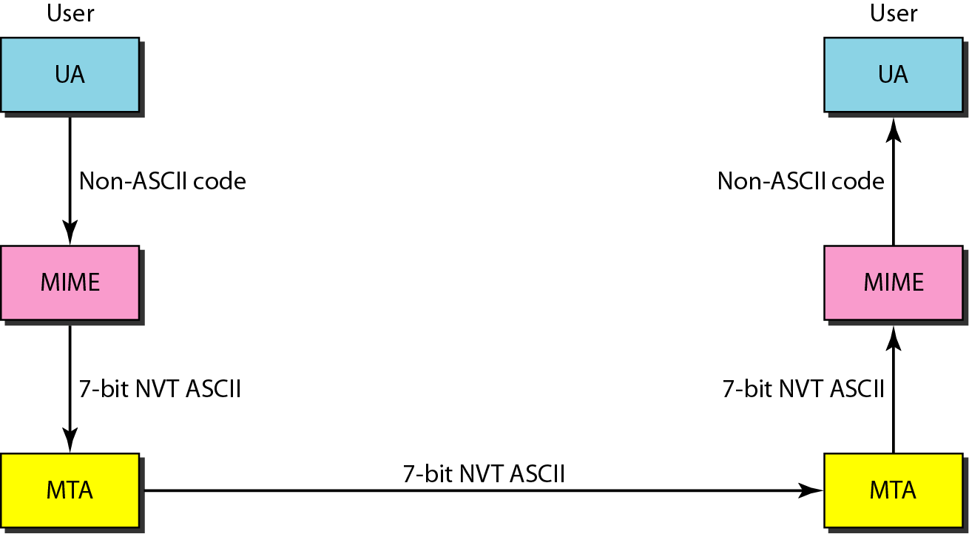
Figure 26.14 MIME
26.<number>

Slide 17
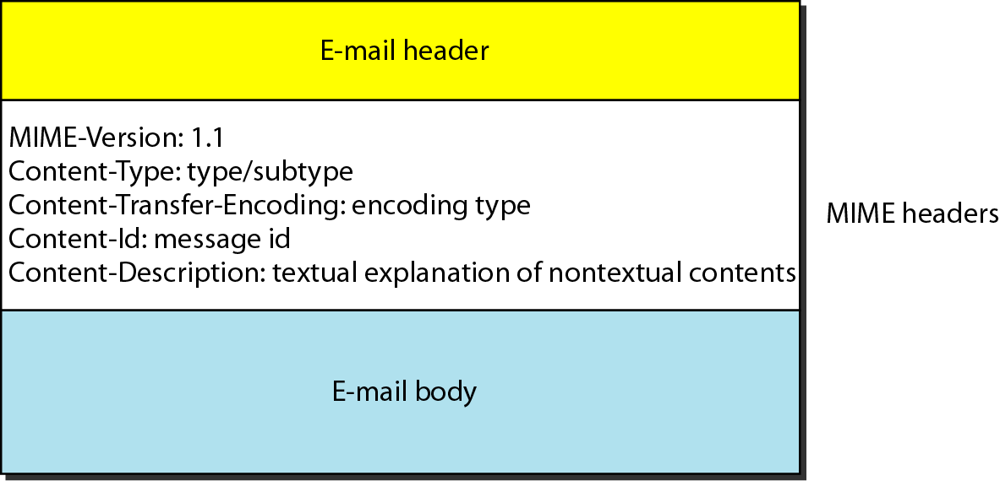
Figure 26.15 MIME header
26.<number>

Slide 18
Table 26.5 Data types and subtypes in MIME
26.<number>

Slide 19
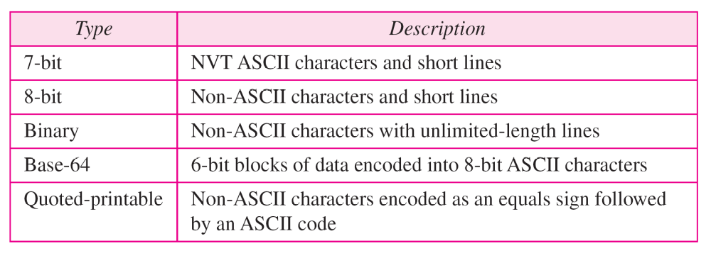
Table 26.6 Content-transfer-encoding
26.<number>

Slide 20
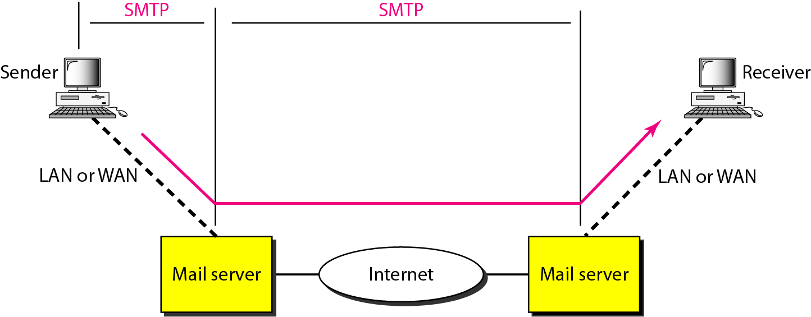
Figure 26.16 SMTP range
26.<number>

Slide 21

Figure 26.17 Commands and responses
26.<number>

Slide 22
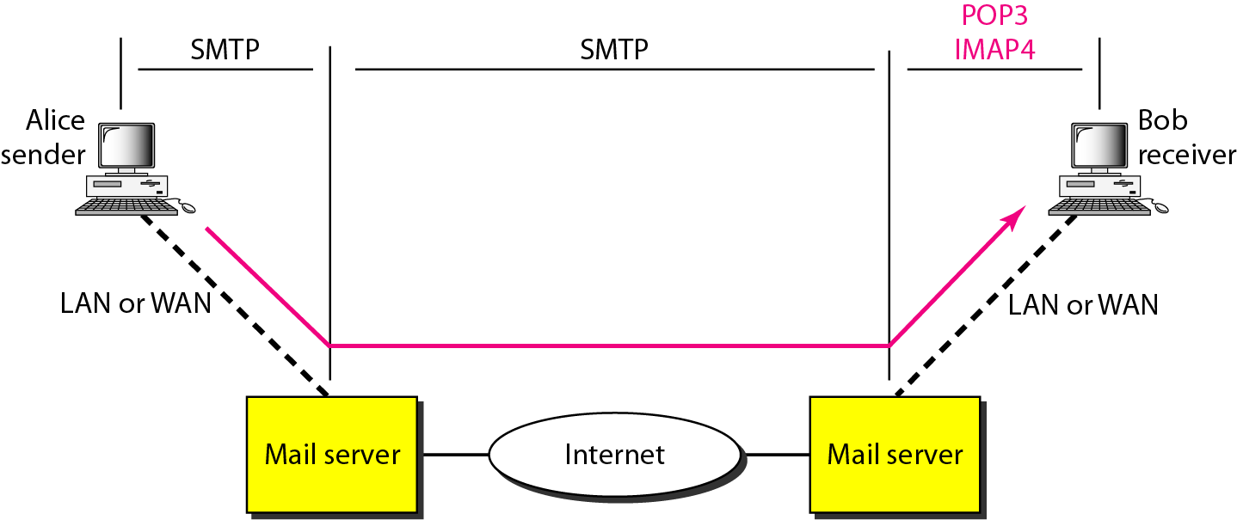
Figure 26.19 POP3 and IMAP4
26.<number>

Slide 23
26-3 FILE TRANSFER
Transferring files from one computer to another is one of the most common tasks expected from a networking or internetworking environment. As a matter of fact, the greatest volume of data exchange in the Internet today is due to file transfer.
Topics discussed in this section:
File Transfer Protocol (FTP)
Anonymous FTP
26.<number>

Slide 24
Note
FTP uses the services of TCP. It needs two TCP connections.
The well-known port 21 is used for the control connection and the well-known port 20 for the data connection.
26.<number>

Slide 25
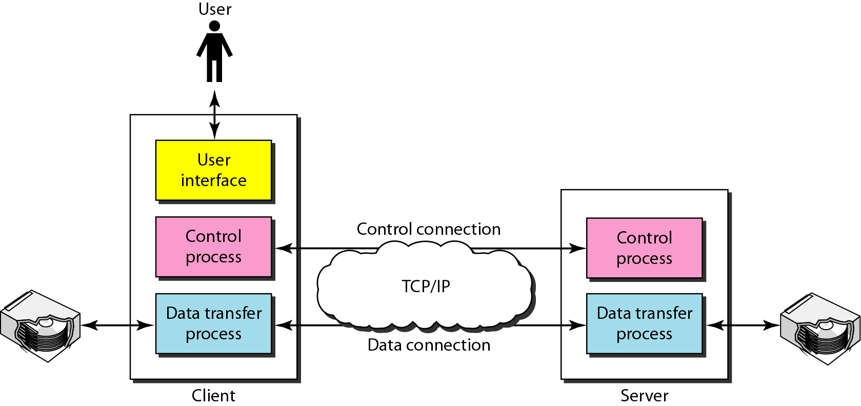
Figure 26.21 FTP
26.<number>

Slide 26
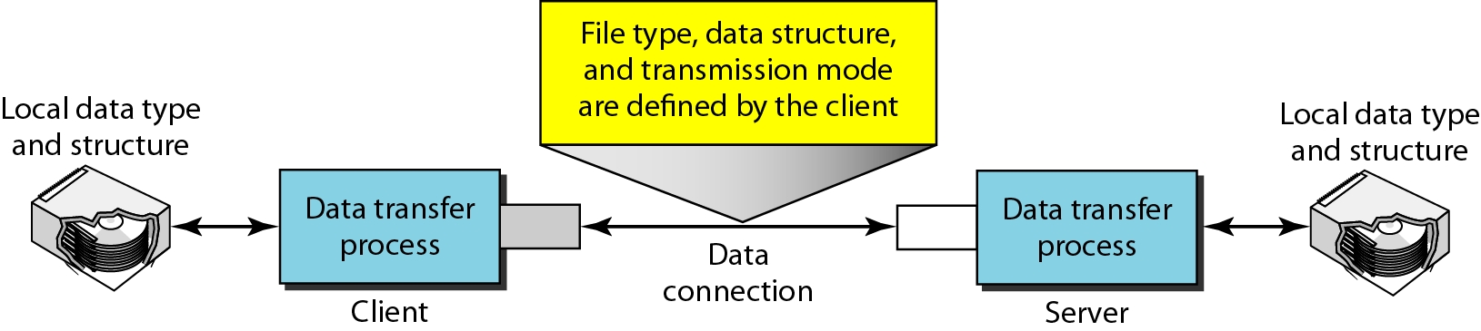
Figure 26.23 Using the data connection
26.<number>

Slide 27
26-1 REMOTE LOGGING
General-purpose client/server program that lets a user access any application program on a remote computer.
Allow the user to log on to a remote computer. After logging on, a user can use the services available on the remote computer and transfer the results back to the local computer.
TELNET enables the establishment of a connection to a remote system in such a way that the local terminal appears to be a terminal at the remote system
Topics discussed in this section:
TELNET
26.<number>

Slide 28
Note
TELNET is a general-purpose client/server application program.
26.<number>

Slide 29
Chapter 27
WWW and HTTP
27.<number>
Copyright © The McGraw-Hill Companies, Inc. Permission required for reproduction or display.

Slide 30
27-1 ARCHITECTURE
The WWW today is a distributed client/server service, in which a client using a browser can access a service using a server. However, the service provided is distributed over many locations called sites.
Topics discussed in this section:
Client (Browser)
Server
Uniform Resource Locator
Cookies
27.<number>

Slide 31

Figure 27.1 Architecture of WWW
27.<number>

Slide 32
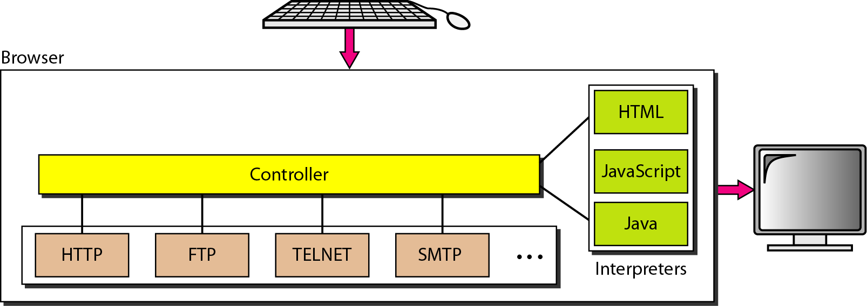
Figure 27.2 Browser
27.<number>

Slide 33
Figure 27.3 URL
27.<number>

Slide 34
27-2 WEB DOCUMENTS
The documents in the WWW can be grouped into three broad categories: static, dynamic, and active. The category is based on the time at which the contents of the document are determined.
Topics discussed in this section:
Static Documents
Dynamic Documents
Active Documents
27.<number>

Slide 35
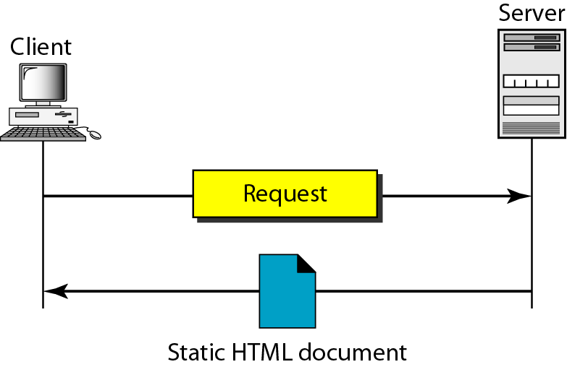
Figure 27.4 Static document
27.<number>

Slide 36
Note
Dynamic documents are sometimes referred to as server-site dynamic documents.
27.<number>

Slide 37
Note
Active documents are sometimes referred to as client-site dynamic documents.
27.<number>

Slide 38
The Hypertext Transfer Protocol (HTTP) is a protocol used mainly to access data on the World Wide Web. HTTP functions as a combination of FTP and SMTP.
An HTTP message is similar in form to an SMTP message.
The HTTP request line consists of a request type, a URL, and the HTTP version number.
27-3 HTTP
Topics discussed in this section:
HTTP Transaction
Persistent Versus Nonpersistent Connection
27.<number>

Slide 39
Note
HTTP uses the services of TCP on well-known port 80.
27.<number>

Slide 40
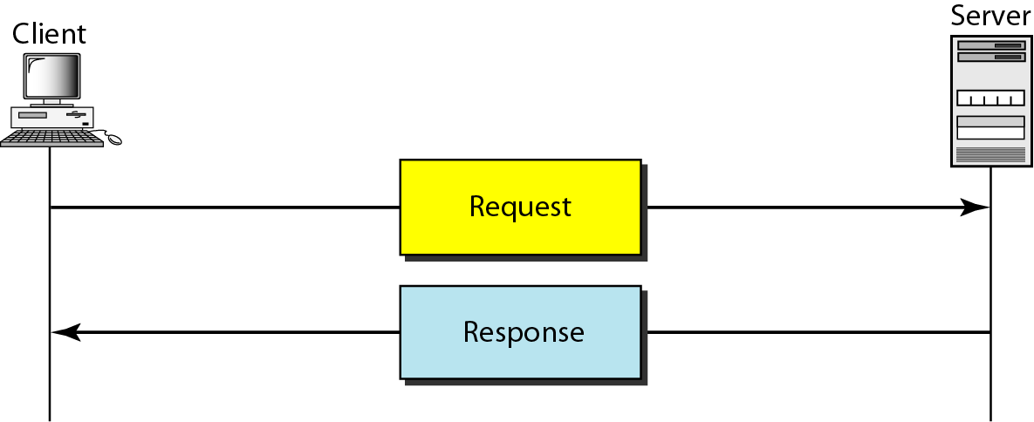
Figure 27.12 HTTP transaction
27.<number>

Slide 41
28-1 NETWORK MANAGEMENT SYSTEM
We can say that the functions performed by a network management system can be divided into five broad categories: configuration management, fault management, performance management, security management, and accounting management.
Topics discussed in this section:
Configuration Management
Fault Management
Performance Management
Security Management
Accounting Management
28.<number>

Slide 42
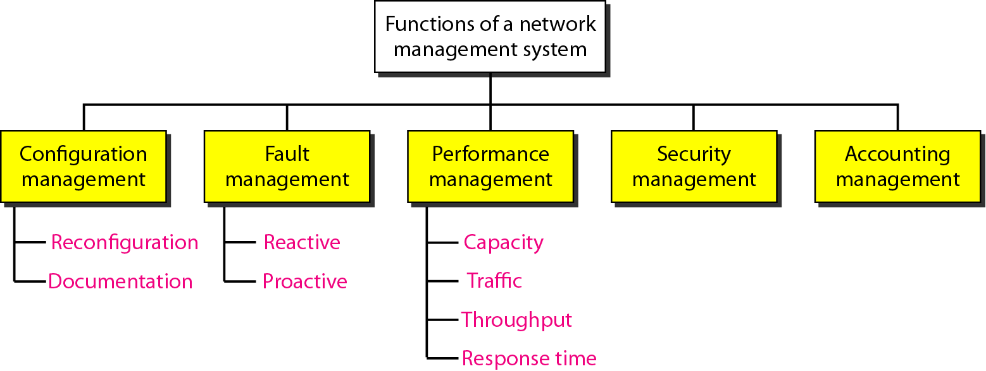
Figure 28.1 Functions of a network management system
28.<number>

Slide 43
28-2 SIMPLE NETWORK MANAGEMENT
PROTOCOL (SNMP)
The Simple Network Management Protocol (SNMP) is a framework for managing devices in an internet using the TCP/IP protocol suite. It provides a set of fundamental operations for monitoring and maintaining an internet.
Topics discussed in this section:
Concept
Management Components
Structure of Management Information (SMI)
Management Information Base (MIB)
SNMP
28.<number>

Slide 44
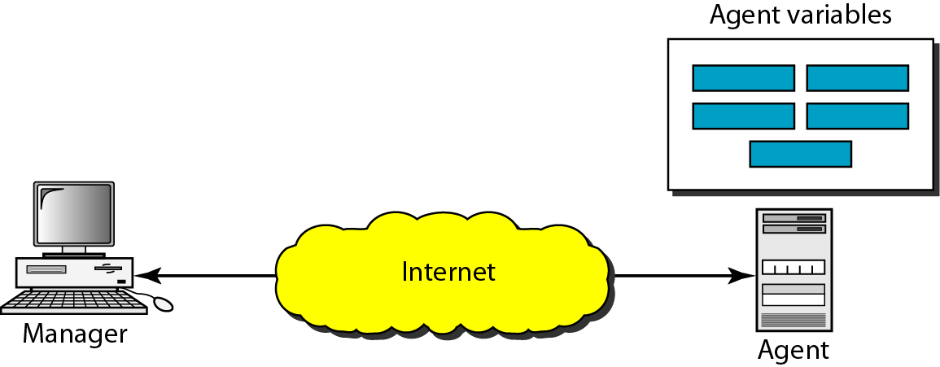
Figure 28.2 SNMP concept
28.<number>

Slide 45
A management station, called a manager, is a host that runs the SNMP client program.
A managed station, called an agent, is a router (or a host) that runs the SNMP server program.
Management is achieved through simple interaction between a manager and an agent.
The agent keeps performance information in a database. The manager has access to the values in the database.
The manager can also make the router perform certain actions.
Agents can also contribute to the management process.
The server program running on the agent can check the environment, and if it notices something unusual, it can send a warning message, called a trap, to the manager.
26.<number>

Slide 46
SNMP Functions
SNMP functions in three ways:
A manager can retrieve the value of an object defined in an agent.
A manager can store a value in an object defined in an agent.
An agent can send an alarm message to the manager.

Slide 47
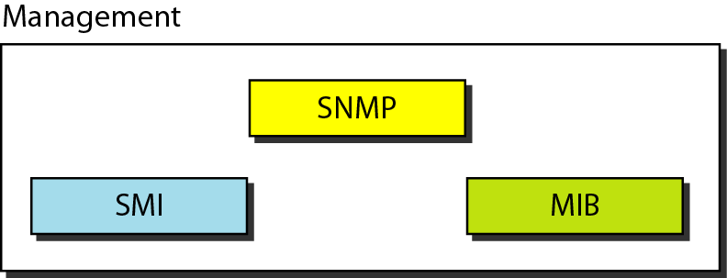
Figure 28.3 Components of network management on the Internet
28.<number>

Slide 48
Note
SNMP defines the format of packets exchanged between a manager and
an agent. It reads and changes the status (values) of objects (variables)
in SNMP packets.
28.<number>

Slide 49
Note
SMI defines the general rules for naming objects, defining object types (including
range and length), and showing how to encode objects and values. SMI does not define the number of objects an entity should manage or name the objects to be managed or define the association between the objects and their values.
28.<number>

Slide 50
SMI
To name objects
To define the type of data that can be stored in an object 3.
To show how to encode data for transmission over the network.
SMI is a guideline for SNMP. It emphasizes three attributes to handle an object: name, data type, and encoding method
26.<number>

Slide 51
Note
MIB creates a collection of named objects, their types, and their relationships to each other
in an entity to be managed.
28.<number>

Slide 52
Note
We can compare the task of network management to the task of writing a program.
❏ Both tasks need rules. In network
management this is handled by SMI.
❏ Both tasks need variable declarations. In
network management this is handled by MIB.
❏ Both tasks have actions performed by
statements. In network management this is
handled by SNMP.
28.<number>

Slide 53
Note
All objects managed by SNMP are given an object identifier.
The object identifier always starts with 1.3.6.1.2.1.
28.<number>

Slide 54
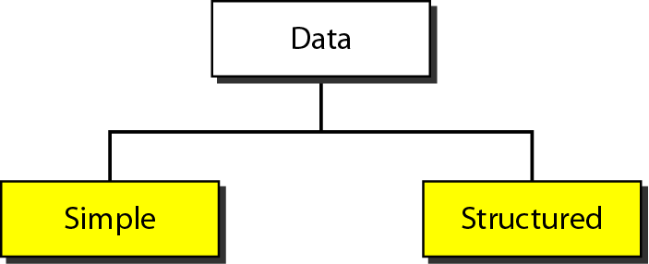
Figure 28.7 Data type
28.<number>

Slide 55
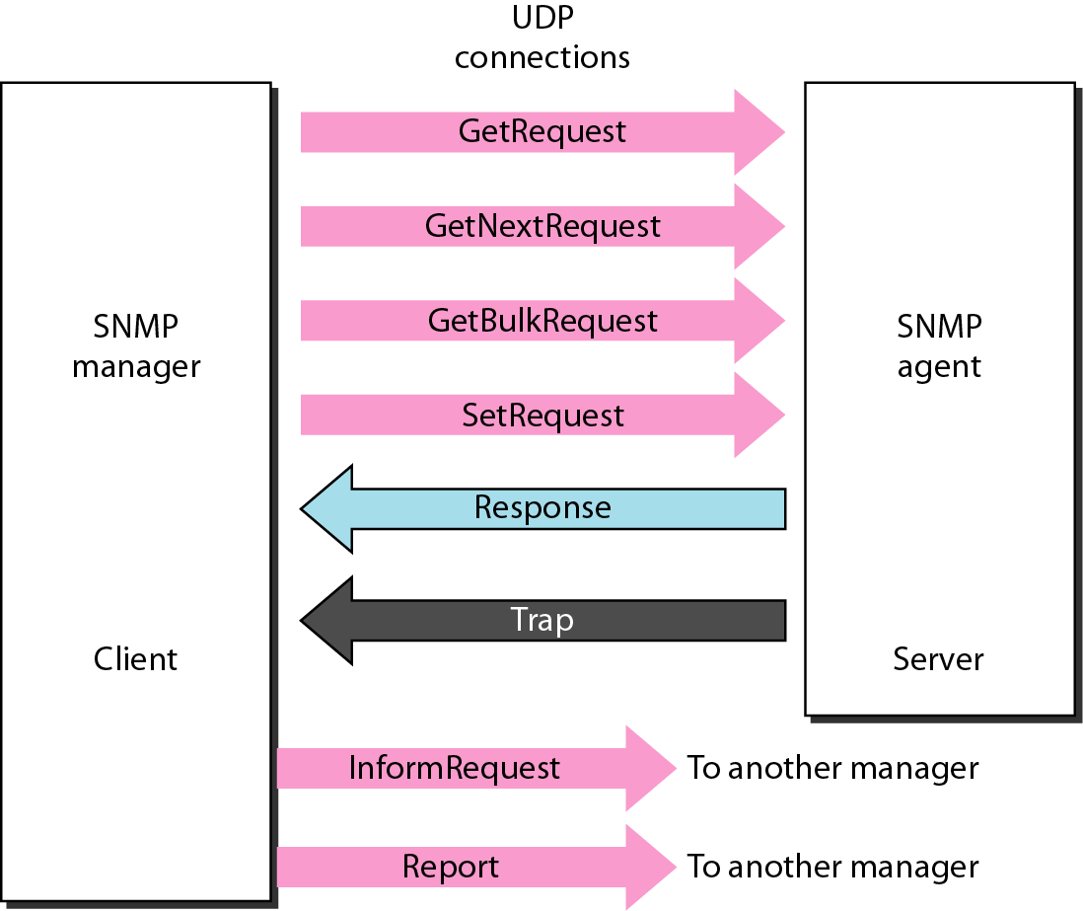
Figure 28.20 SNMP PDUs
28.<number>

Slide 56
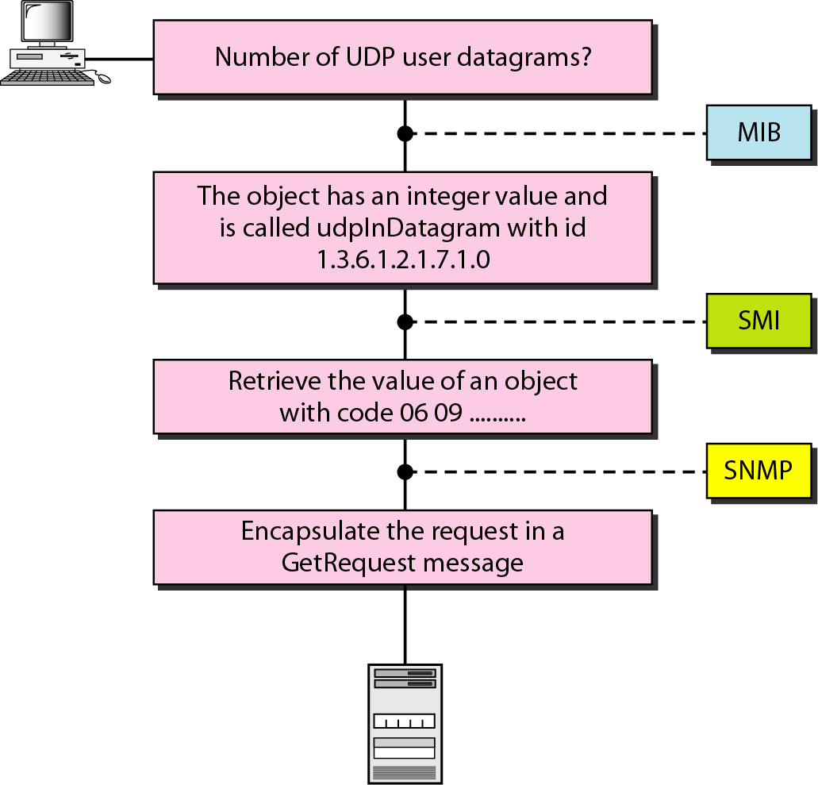
Figure 28.4 Management overview
28.<number>

Slide 57
A manager station (SNMP client) wants to send a message to an agent station (SNMP server) to find the number of UDP user datagrams received by the agent.
MIB is responsible for finding the object that holds the number of the UDP user datagrams received.
SMI, with the help of another embedded protocol, is responsible for encoding the name of the object.
SNMP is responsible for creating a message, called a GetRequest message, and encapsulating the encoded message.
1. To name objects 2. To define the type of data that can be stored in an object 3. To show how to encode data for transmission over the network SMI is a guideline for SNMP. It emphasizes three attributes to handle an object: name, data type, and encoding method
26.<number>

Slide 58
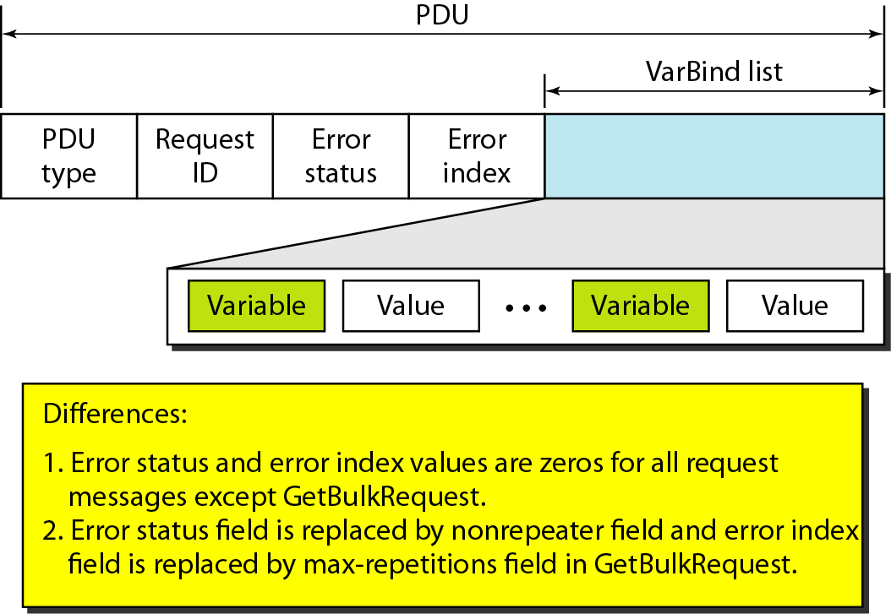
Figure 28.21 SNMP PDU format
28.<number>

Slide 59
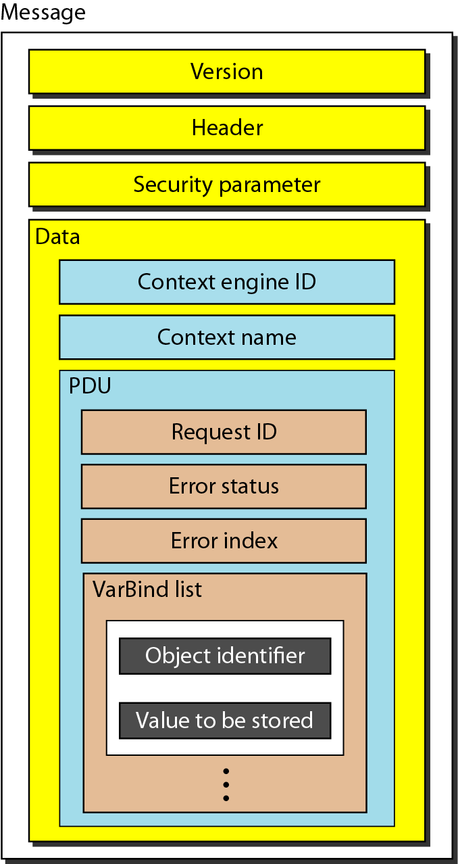
Figure 28.22 SNMP message
28.<number>

Slide 60
UDPPorts
SNMP uses the services of UDP on two well-known ports, 161 and 162. The well-known port 161 is used by the server (agent), and the well-known port 162 is used by the client (manager)
57

Slide 61
SNMPv3- Enhanced Security
SNMPv3 provides message authentication, privacy, and manager authorization.
The first two are part of the User-Based Security model (USM), and the last is defined in the View-Based Access Control Model (VACM)
SNMPv3 allows a manager to remotely change the security configuration, which means that the manager does not have to be physically present at the manager station.
58

